Slide 1
Capstone Project
The Battle of Neighbourhoods

Slide 2
Safest Borough in Toronto City
Using K-means Clustering

Slide 3
Introduction
Toronto “City of Neighbourhoods” with 140 neighbourhoods and 6 boroughs
The project aims to find the safest borough and appropriate neighbourhoods to start a business establishment like a grocery store
Explore the crime rate and pattern of Toronto and each borough.
Based on the crime data, explore the neighbourhood of the safest borough to find the 10 most common venues in each neighbourhood and divide them into clusters using k-mean clustering method.

Slide 4
Target Audience
Businessman who wants to explore new opportunities in Toronto for starting business like a grocery store or gym
Security businesses can use the crime Data analysis to develop smart alert system for commercial spaces.

Slide 5
Data Acquisition and Cleaning

Slide 6
Data Acquisition
First set of data is crime data for Toronto which is acquired from official Toronto police website. The crime data is from 2013 to 2019. Data set URL: https://data.torontopolice.on.ca/datasets/mci-2014-to-2019
Second Source of data was acquired using web scraping method from Wikipedia link https://en.wikipedia.org/wiki/List_of_city-designated_neighbourhoods_in_Toronto
Third dataset is geojson file for neighbourhoods of Toronto. This was used in the visualisation section of the project. The data was acquired from website URL https://nad.carto.com/tables/neighbourhoods_toronto/public/map

Slide 7
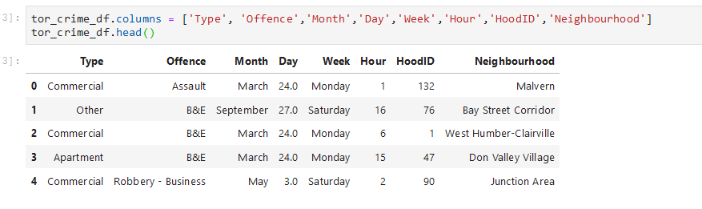
Data Cleaning
For Toronto crime dataset, the crimes for the recent year i.e. 2019 year was selected
Renaming of column to simpler names

Slide 8
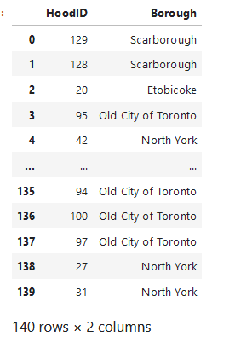
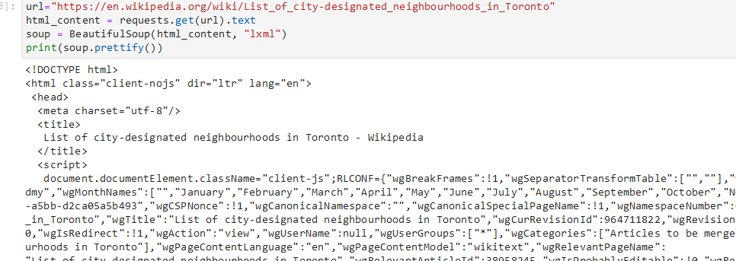
Data Cleaning
Beautiful soup package was used to do webscraping to extract list of borough and hood id
Only neighbourhood and hood id column kept to map to respective borough

Slide 9
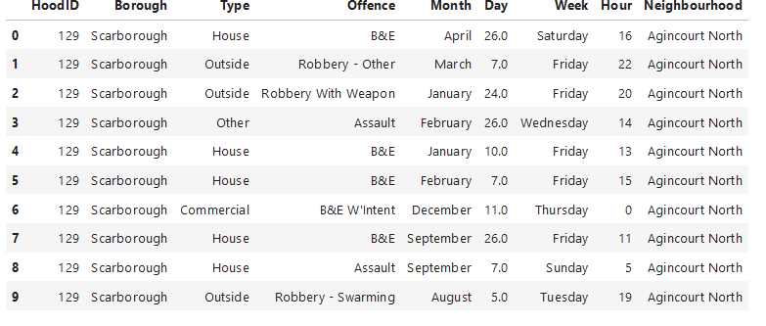
Data Cleaning
Data was merged using two table with hood id as primary key.

Slide 10
Exploratory Data Analysis
We have considered only data for crimes on commercial properties.
Exploring the crime pattern and analysis daywise, hourwise.

Slide 11
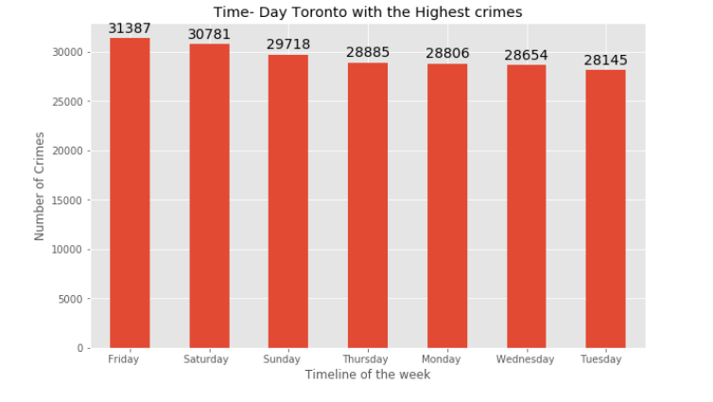
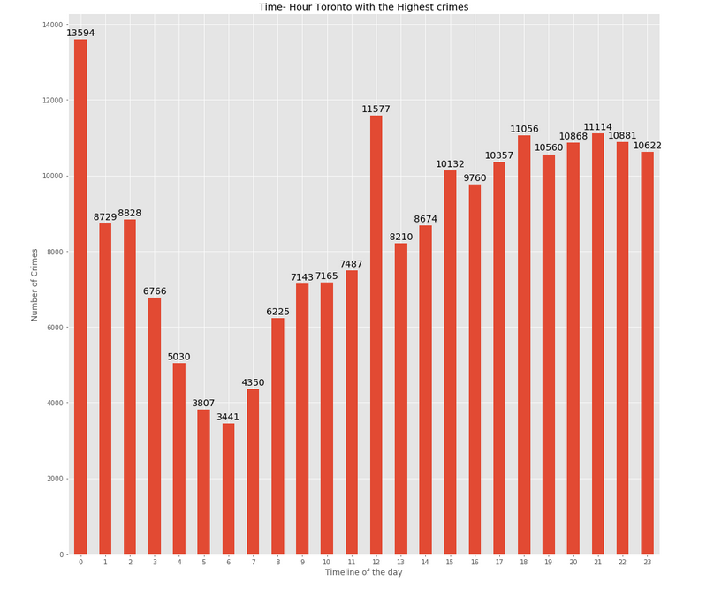
Crime Pattern Analysis

Slide 12
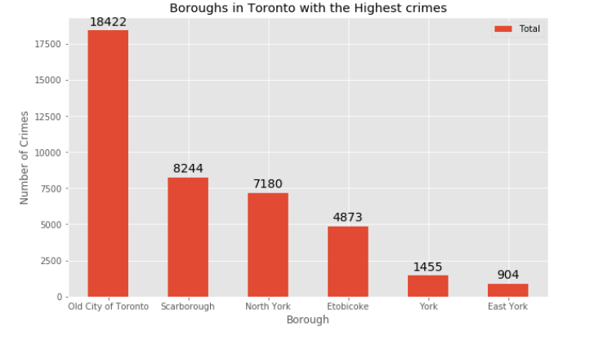
Crime is lowest in East York and followed by York borough
Highest in Old city of Toronto , but majority of neighbourhoods are located within that borough
East York – 8 neighbourhoods
York – 10 neighbourhoods

Slide 13
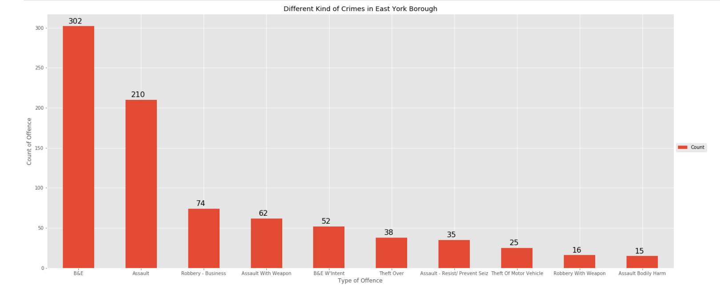
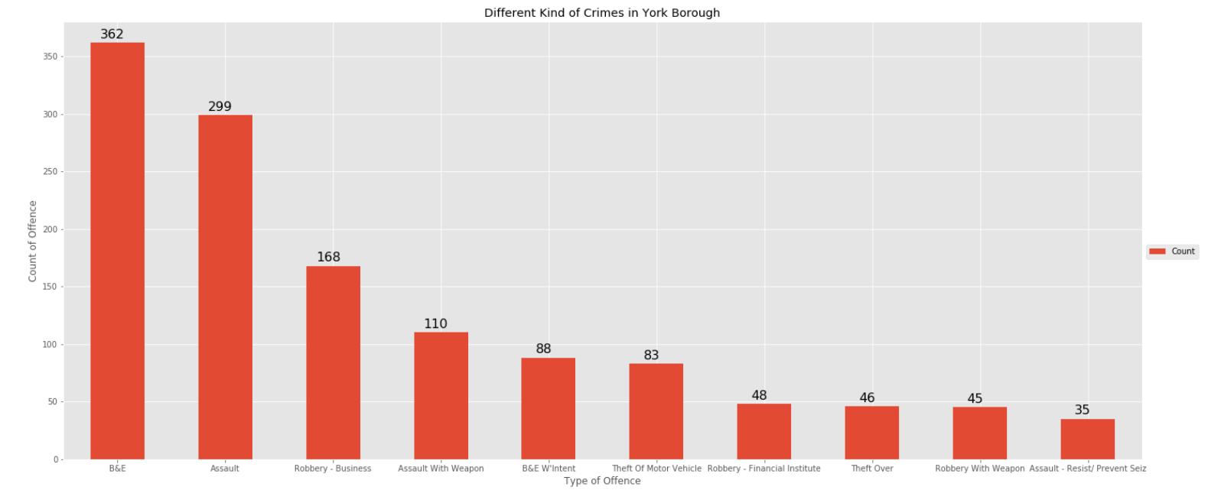
Comaprison East York vs York

Slide 14
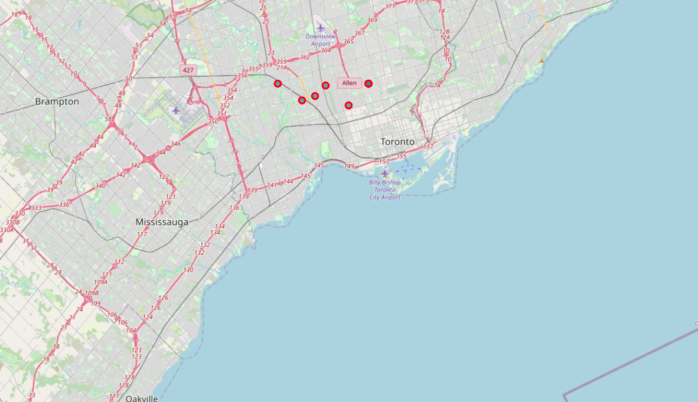
Visualisation of Neighbourhoods on Map

Slide 15
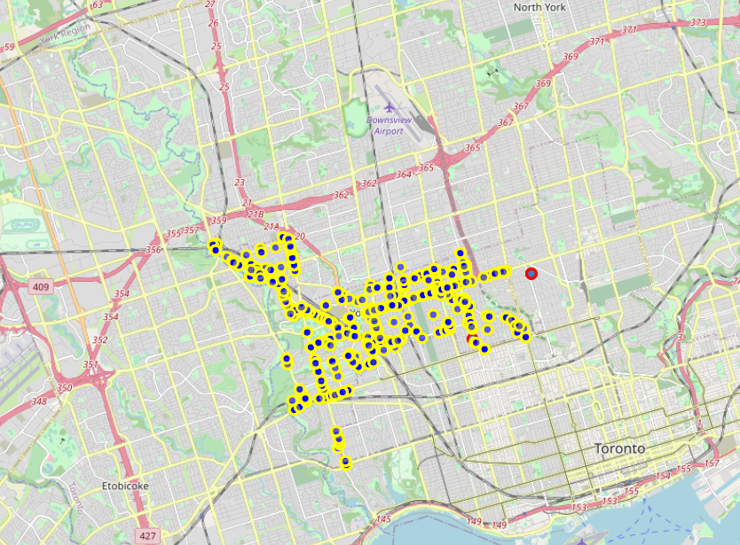
Visualisation of Neighbourhoods on Map
Plotting of neighbourhoods on map
Plotting the crime data on same map

Slide 16
Modelling

Slide 17
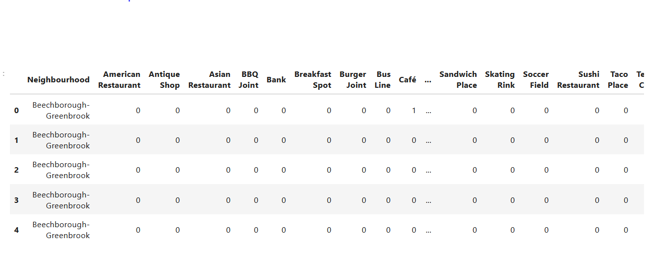
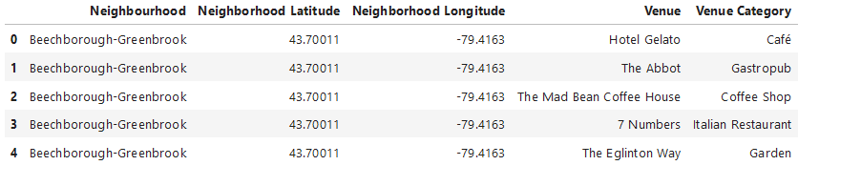
One Hot Encoding
Venues in neighbourhood within 500 M radius of Toronto Center
Foursquare API was used to extract the venue data on the location.
One hot encoding is done on the venues data

Slide 18
Results

Slide 19
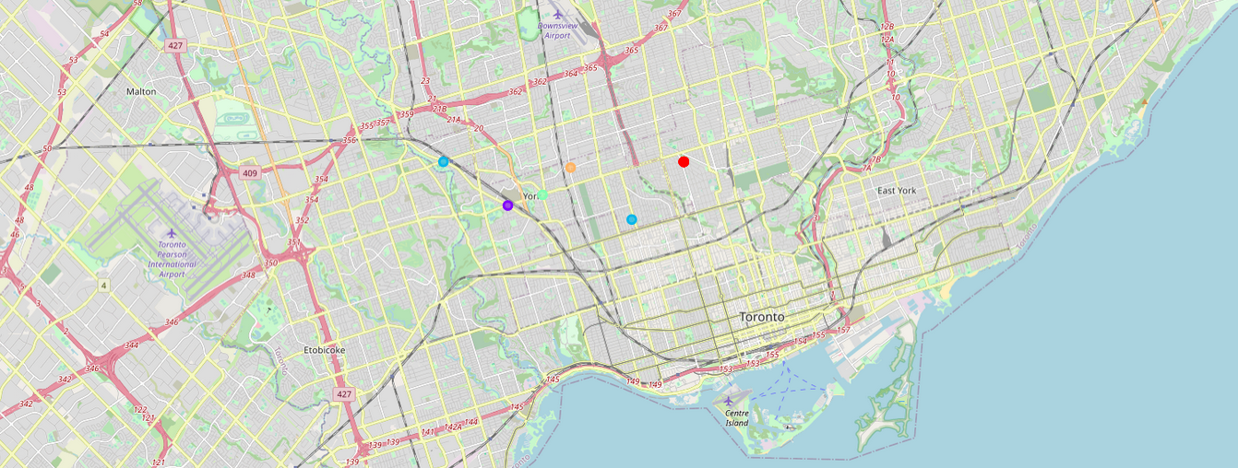
K-Clustering
Number of cluster -5
Each cluster is denoted with different colour code
Total 10 neighbourhoods divided into 5 clusters according to most common venues

Slide 20
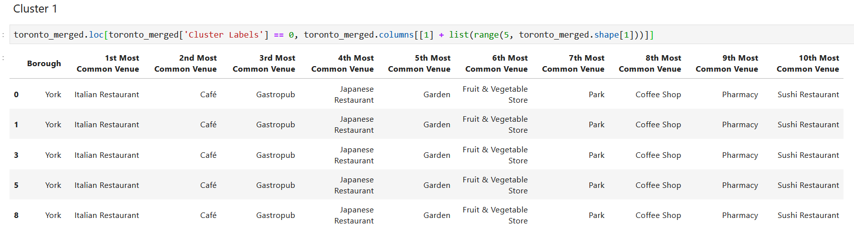
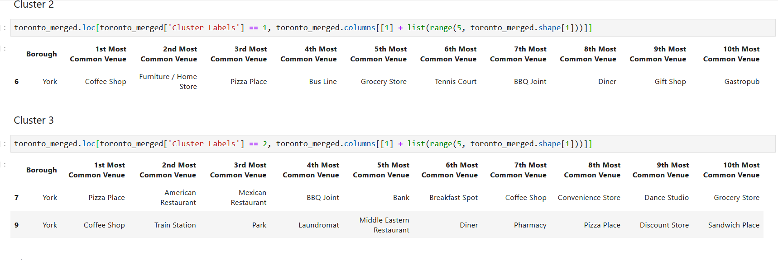
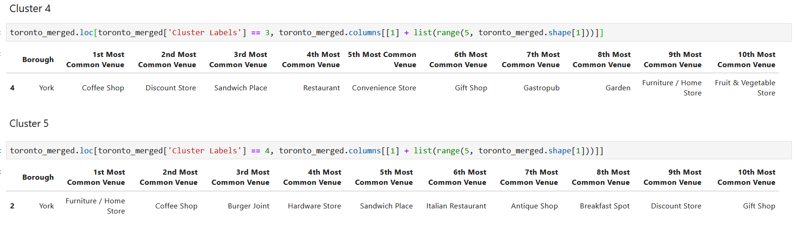

Slide 21
Discussion

Slide 22
The objective of the business problem was to help stakeholders identify one of the safest boroughs in Toronto
Appropriate neighbourhood within the borough to set up a commercial establishment especially like a Grocery store
Choose the right neighbourhood where grocery shops were not among venues in a close proximity to each other
Achieved by grouping the neighbourhoods into clusters
Assist the stakeholders by providing them with relevant data about venues and safety of a given neighbourhood

Slide 23
Conclusion

Slide 24
Explored the crime data to understand different types of crimes in all neighbourhoods of Toronto
Using K-Clustering it is easy to group locations with similar venue category
The model can be reused for any location and find any other type of business opportunities as well
Future scope could be to consider factors like the neighbourhood profile, economic factors

Slide 25
Thank You

